Slide 1
Lasers Principle and Production – Introduction to Lasers

Slide 2
Unit 4 – (Lasers)
Unit 4 – (Lasers): Interaction of radiation with matter - Absorption, spontaneous emission and stimulated emission - Characteristics of laser light - Expression for the energy density of electromagnetic radiation – Requisite conditions for production of a laser beam—Helium-Neon laser—Semiconductor laser—Applications of lasers—Lidar—laser isotope separation—laser fusion
Syllabus

Slide 3
Objectives
At the end of this lecture, students should be able to:
Recollect the basic ideas about light and atom
Explain the phenomena absorption, emission and stimulated emission
Discuss the properties of Laser

Slide 4
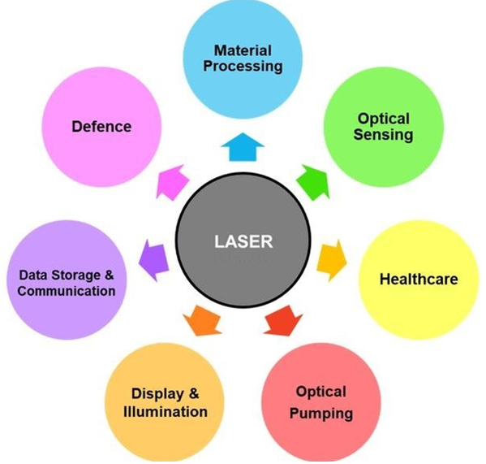
LASER
LASER - Light Amplification by Stimulated Emission of Radiation
It is a device that emit light having unique properties compared to the light being emitted by conventional sources of light such as incandescent bulb, Mercury vapor lamp, etc.,
Laser has found innumerable applications in various fields because of their unique properties of the light being emitted by them.
The fundamental principles of laser operation are largely based on quantum mechanics

Slide 5
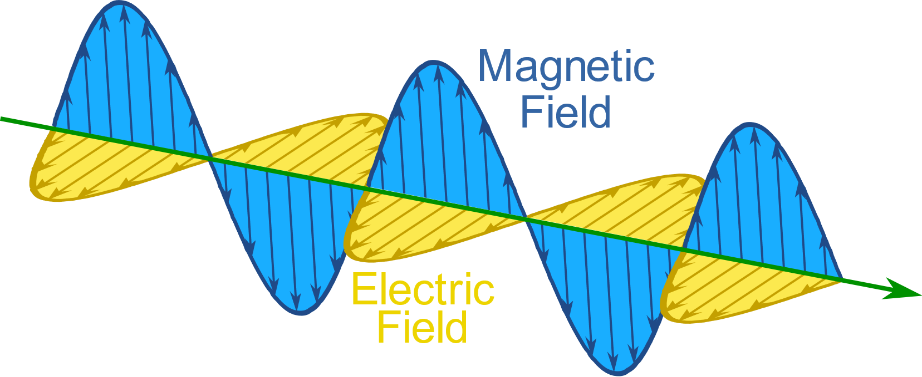
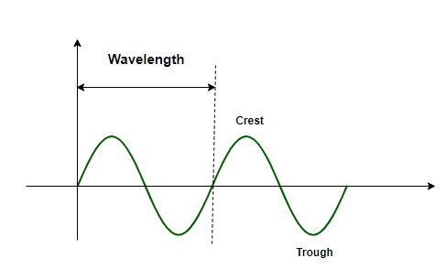
Light
Wave with velocity c = 3 × 10⁸ m/s
Electromagnetic radiation
No medium is required
Wavelength - Wavelength (λ) is the distance between two consecutive crests or troughs of a wave
Frequency - is the number of cycles of a wave that pass a given point per unit of time. It is commonly measured in hertz (Hz)
Velocity of light = wavelength × frequency

Slide 6
Light
- Form of Electromagnetic Radiation
Visible to the Human Eye
Spectrum of Wavelengths
- Composed of Photons
Elementary Particles
Exhibit Wave-Particle Duality
- Characteristics of Light
Travels in Straight Lines
Constant Speed in Vacuum
- Electromagnetic Spectrum
Range of Wavelengths
Includes Infrared, Visible, and Ultraviolet Light
- Role of Light
Illuminates Surroundings
Enables Vision
Crucial in Science, Technology, Medicine, and Art

Slide 7
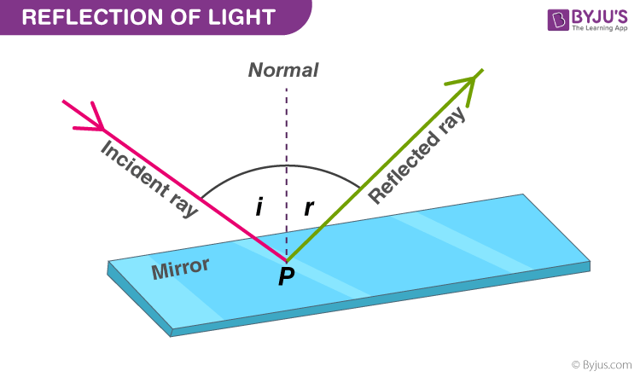
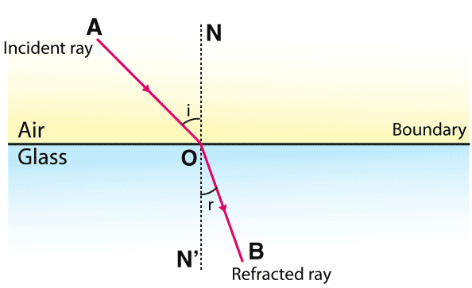
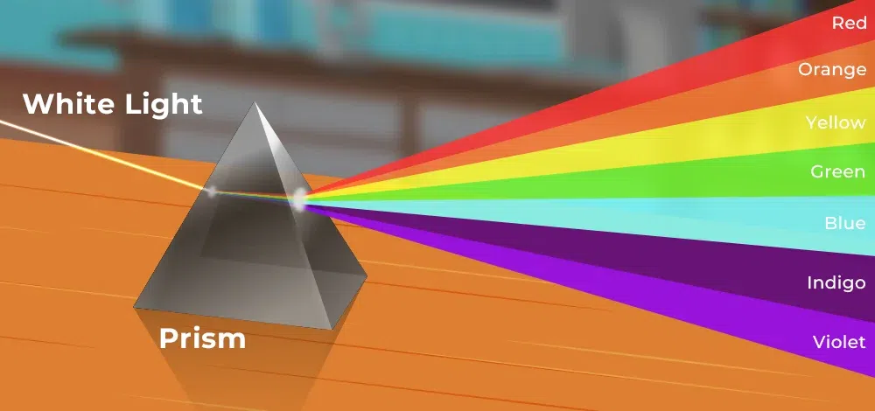
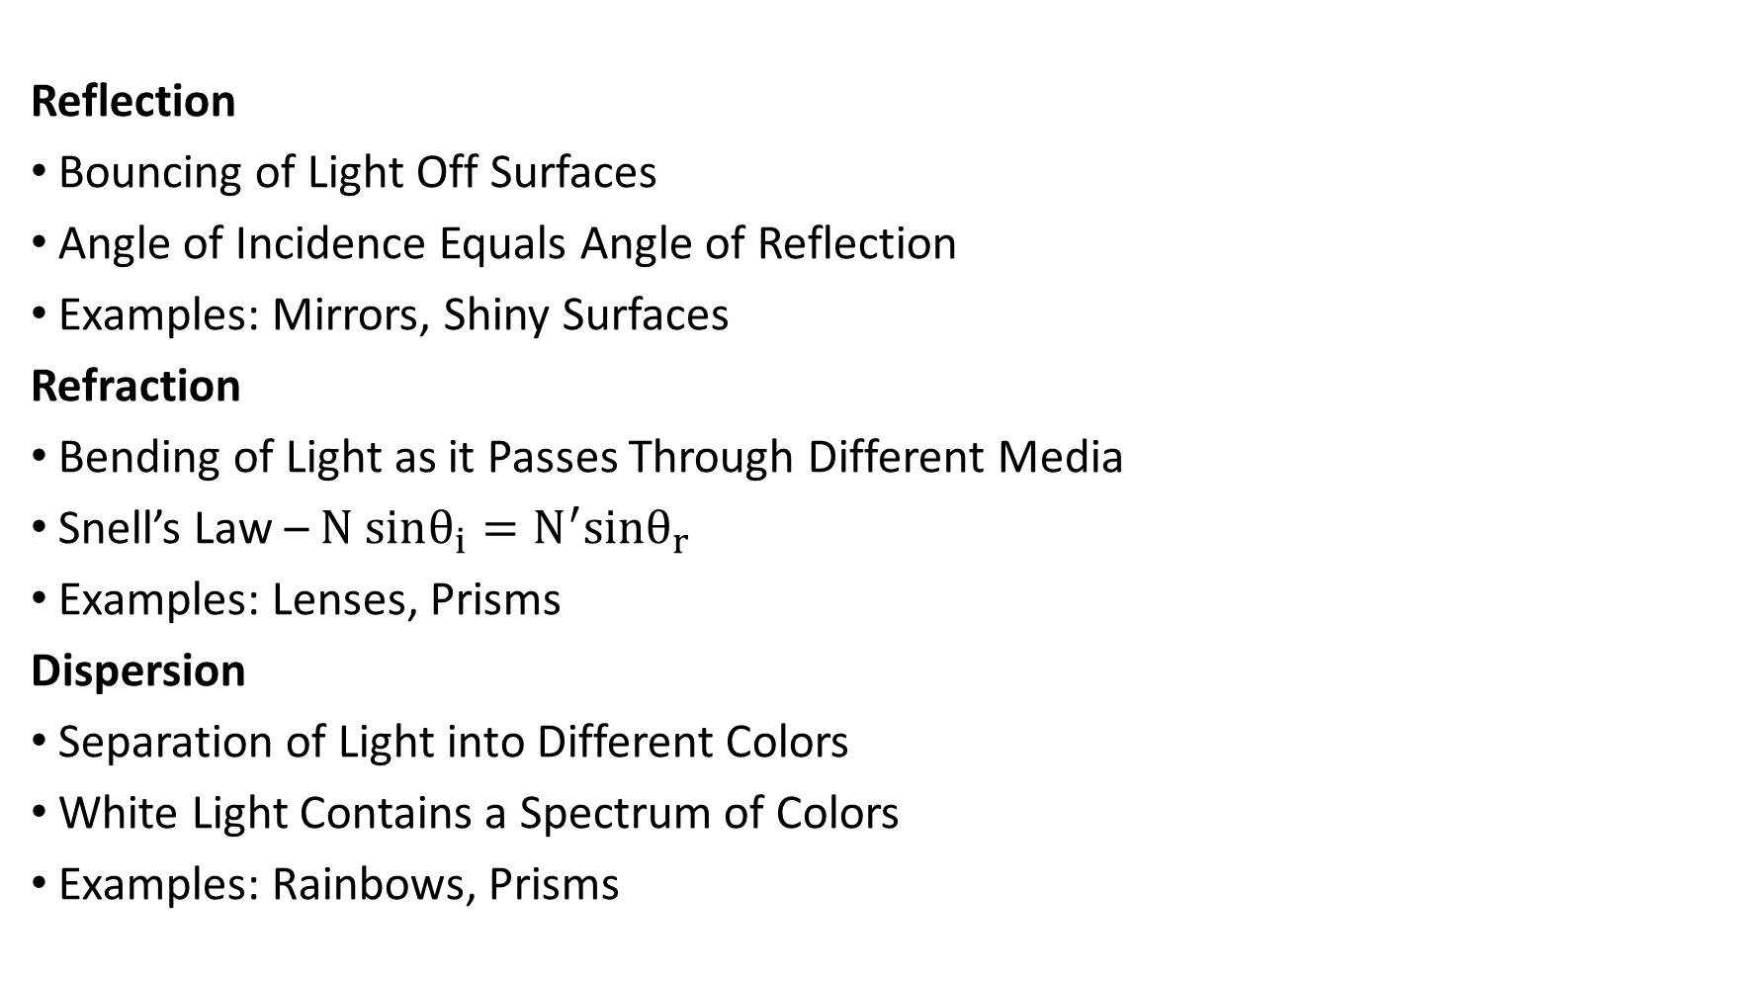
Properties of Light
Reflection
Bouncing of Light Off Surfaces
Angle of Incidence Equals Angle of Reflection
Examples: Mirrors, Shiny Surfaces
Refraction
Bending of Light as it Passes Through Different Media
Snell’s Law – $N sinθ_{i}=N^{′}sinθ_{r}$
Examples: Lenses, Prisms
Dispersion
Separation of Light into Different Colors
White Light Contains a Spectrum of Colors
Examples: Rainbows, Prisms

Slide 8
Properties of Light
Polarization
Orientation of Light Waves
Light Waves Oscillate in a Particular Plane
Polarizing Filters Selectively Transmit Light Waves
Diffraction
Bending of Light Around Obstacles
Wave Nature of Light Causes Diffraction
Examples: Interference Patterns, Patterns of Light and Dark Bands
Interference
Interaction of Light Waves Leading to Bright or Dark Fringes
Occurs When Waves Overlap
Examples: Young's Double Slit Experiment, Soap Bubbles
Scattering
Random Deviation of Light by Small Particles
Causes Light to Scatter in Different Directions
Examples: Blue Sky, White Clouds

Slide 9
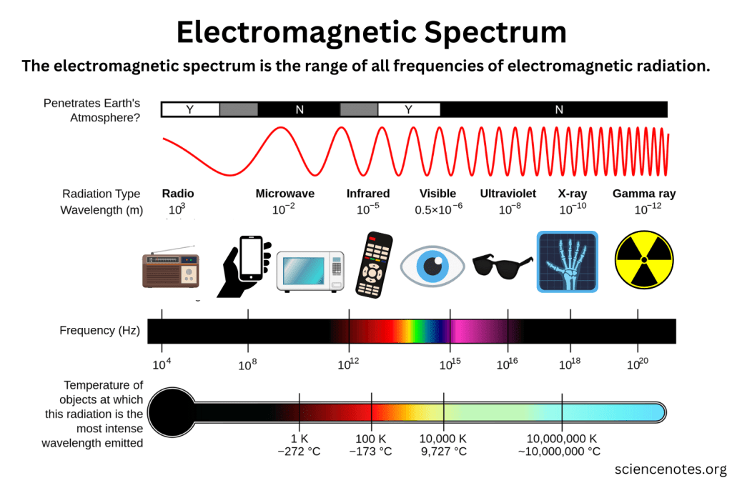
Colour of Light

Slide 10
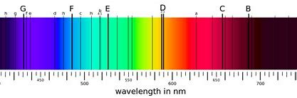
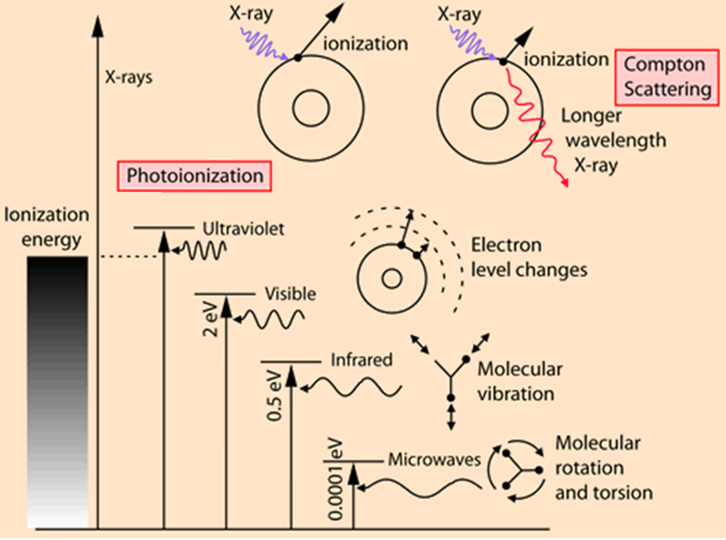
Interaction of Radiation With Matter

Slide 11

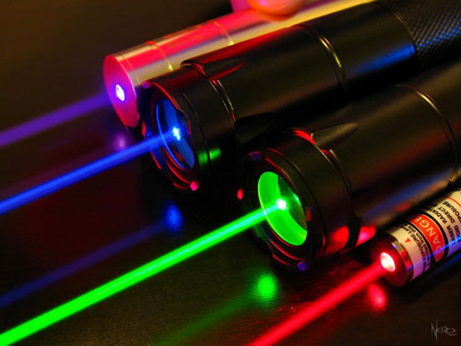
Properties of Light from a Laser
Ordinary light
Polychromatic – Constitute more than one wavelength
Incoherent – Photons will not be in same phase with each other
Non-directional – Photons travels in different direction and exhibit high divergence
Non-Polarized and Less intense
Laser light
Monochromatic – Constitute single wavelength
Coherent – All photons will have same phase and frequency
Directional – All photons travels in same direction and exhibit least divergence
Polarized and High intense
Notes:
1. **Monochromaticity:**
- Laser light is highly monochromatic, meaning it consists of a single wavelength or color. This characteristic distinguishes laser light from other sources, such as light bulbs, which emit a broad spectrum of wavelengths.
2. **Coherence:**
- Laser light is coherent, meaning the waves emitted by a laser are in phase with each other. This coherence allows laser light to be focused into a tight beam that maintains its intensity and direction over long distances, making it ideal for applications such as laser cutting and holography.
3. **Directionality:**
- Laser light is highly directional, meaning it travels in a narrow beam with minimal divergence. This property allows laser light to be precisely directed and focused, making it useful for applications such as laser pointers, barcode scanners, and laser surgery.
4. **High Intensity:**
- Laser light is characterized by its high intensity, meaning it carries a large amount of energy per unit area. This property makes laser light capable of producing intense heat or light output, allowing it to be used in applications such as laser welding, laser engraving, and laser therapy.
5. **Polarization:**
- Laser light can be polarized, meaning the electric field oscillates in a specific orientation. This property allows for control over the orientation of the light waves, which is useful in applications such as optical communications and 3D movie projection.

Slide 12
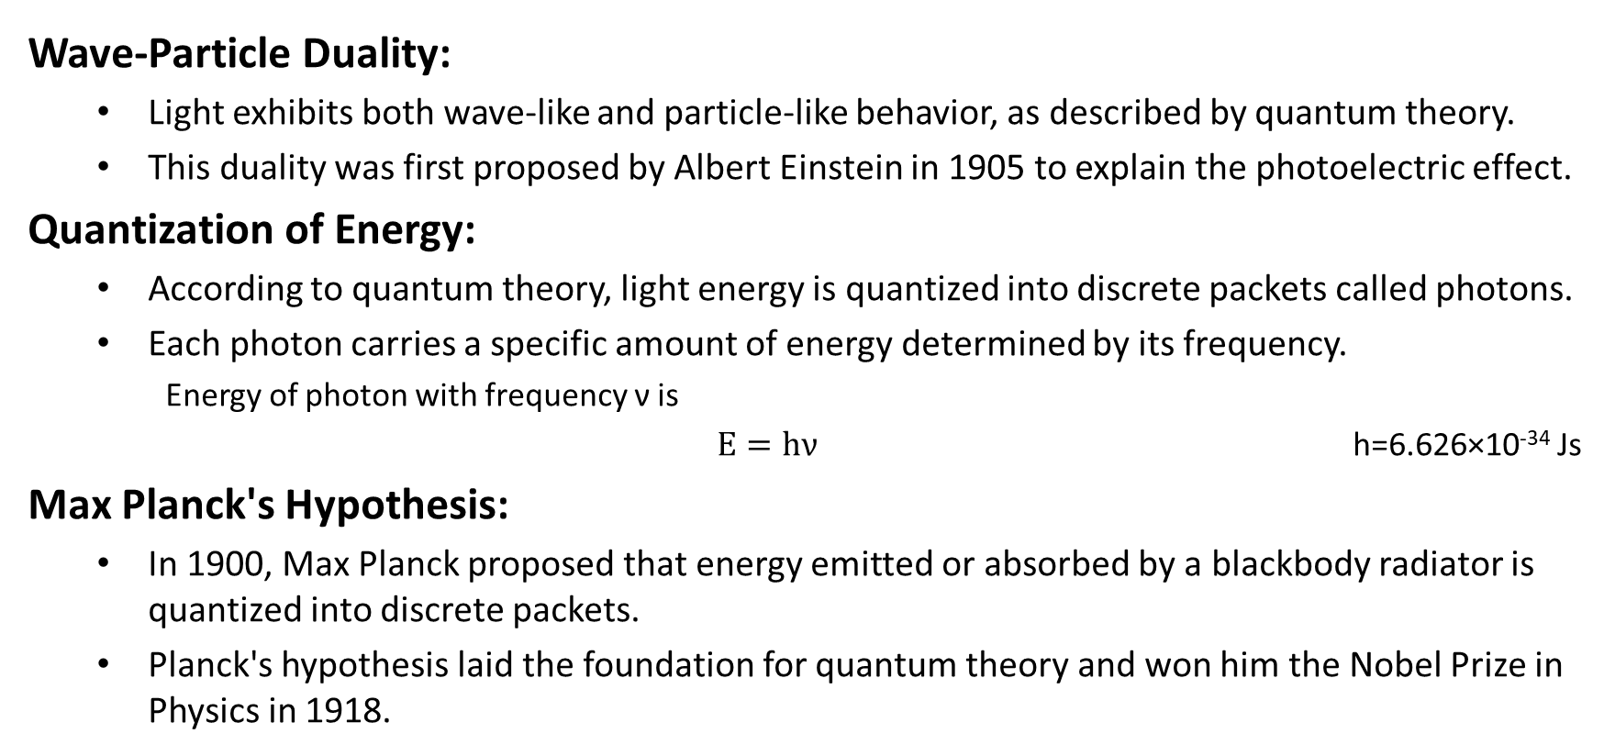
Quantum Theory of Light
Wave-Particle Duality:
Light exhibits both wave-like and particle-like behavior, as described by quantum theory.
This duality was first proposed by Albert Einstein in 1905 to explain the photoelectric effect.
Quantization of Energy:
According to quantum theory, light energy is quantized into discrete packets called photons.
Each photon carries a specific amount of energy determined by its frequency.
Energy of photon with frequency ν is
$E=hν$ h=6.626×10⁻³⁴ Js
Max Planck's Hypothesis:
In 1900, Max Planck proposed that energy emitted or absorbed by a blackbody radiator is quantized into discrete packets.
Planck's hypothesis laid the foundation for quantum theory and won him the Nobel Prize in Physics in 1918.

Slide 13
Quantum Theory of Light
Wave-Particle Nature in Experiments:
Light behaves as waves in interference and diffraction experiments, where it exhibits interference patterns and undergoes bending around obstacles.
Light also behaves as particles in experiments like the photoelectric effect, where individual photons interact with matter.

Slide 14
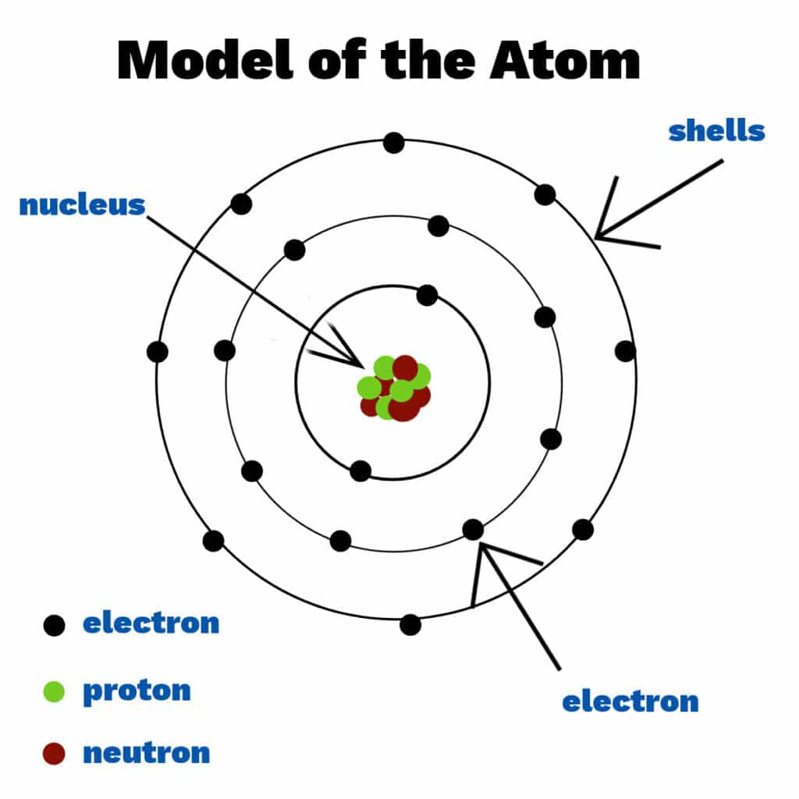
Atom
An atom is the smallest unit of an element that retains the chemical properties of that element.
Composition: Atoms consist of three subatomic particles:
Protons
neutrons, and
Electrons
Nucleus: The nucleus is located at the center of the atom and contains the majority of the atom's mass. It is composed of protons and neutrons tightly bound together by the strong nuclear force.
Electron can jump from one orbit to other by gaining (or loosing) energy
Notes:
Protons carry a positive charge, neutrons are electrically neutral, and electrons carry a negative charge.

Slide 15
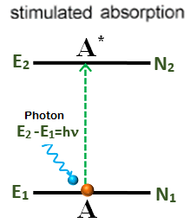
Stimulated Absorption
Stimulated absorption is a process that occurs when an atom or molecule absorbs a photon of light and is then induced to transition to a higher energy state by interacting with another photon.
Atom absorbs a photon of frequency (Δ𝐸 = ℎ𝜈) and get excited to the higher energy level.

Slide 16
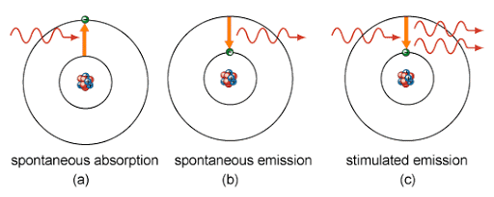
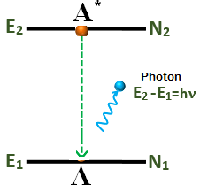
Spontaneous Emission
Spontaneous emission is a process in which an atom or molecule in an excited state spontaneously transitions to a lower energy state by emitting a photon of light without any external stimulation.
Atom in the excited energy level comes back to the lower energy level after spending relaxation time (≈10⁻⁸ s) by emitting a photon of energy, Δ𝐸 = ℎ𝜈.

Slide 17
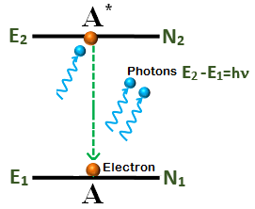
Stimulated Emission
Stimulated emission is a process in which an atom or molecule in an excited state is induced to transition to a lower energy state by interacting with a photon of the same frequency and phase, resulting in the emission of a second photon.
Atom in the excited energy level is forced by a photon of right frequency to comes back to the lower energy level by emitting two photons of energy, Δ𝐸 = ℎ𝜈.

Slide 18
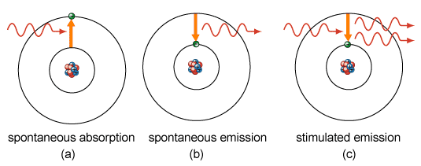
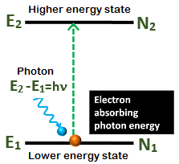
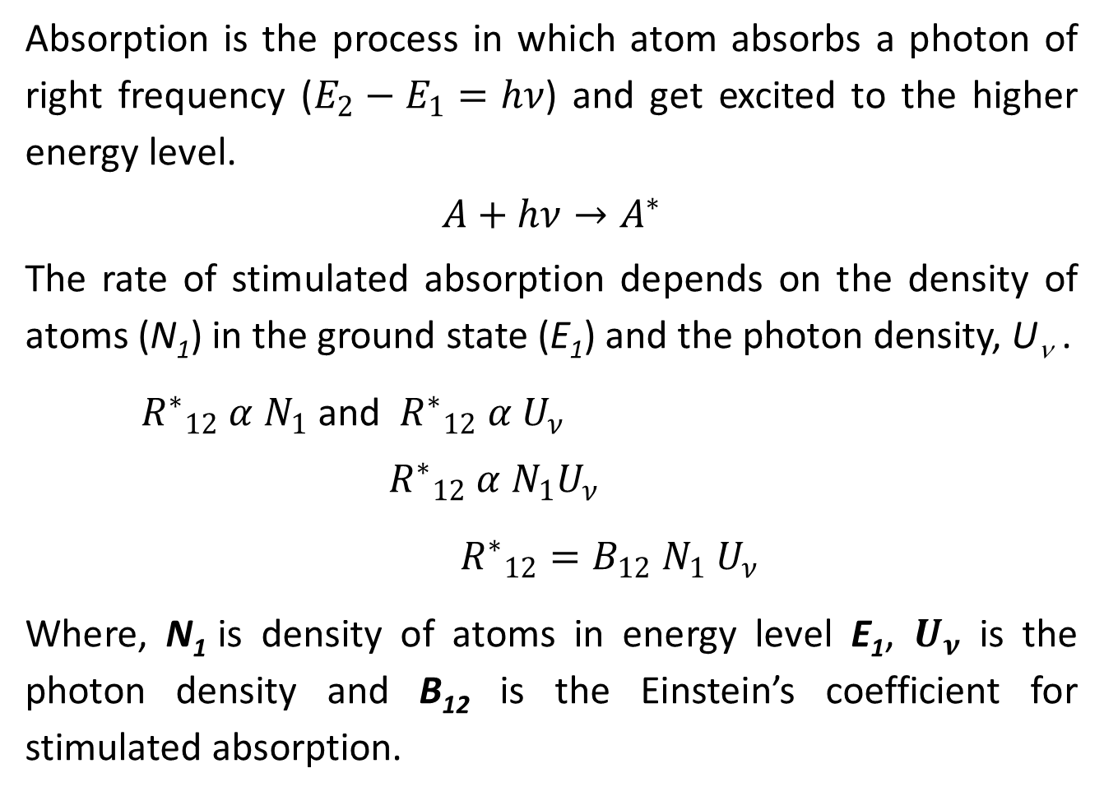
Stimulated Absorption
Absorption is the process in which atom absorbs a photon of right frequency ($E_{2}−E_{1}=hν$) and get excited to the higher energy level.
$$A+hν→A^{∗}$$
The rate of stimulated absorption depends on the density of atoms (N₁) in the ground state (E₁) and the photon density, U_{ν} .
${R^{∗}}_{12} α{ N}_{1}$ and ${R^{∗}}_{12} α U_{ν}$
$${R^{∗}}_{12} α{ N}_{1}U_{ν}$$
${R^{∗}}_{12}=B_{12}{ N}_{1} U_{ν}$
Where, N₁ is density of atoms in energy level E₁, $U_{ν}$ is the photon density and B₁₂ is the Einstein’s coefficient for stimulated absorption.

Slide 19
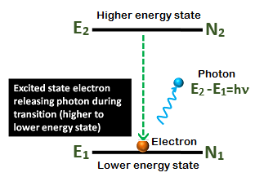
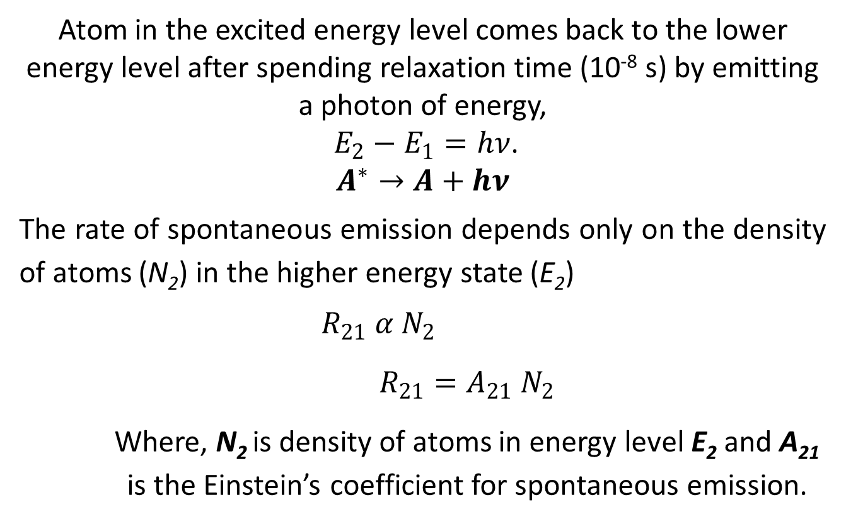
Spontaneous Emission
Atom in the excited energy level comes back to the lower energy level after spending relaxation time (10⁻⁸ s) by emitting a photon of energy, $E_{2}−E_{1}=hν$.
$$A^{∗}→A+hν$$
The rate of spontaneous emission depends only on the density of atoms (N₂) in the higher energy state (E₂)
$$R_{21} α{ N}_{2}$$
$R_{21}=A_{21}{ N}_{2}$
Where, N₂ is density of atoms in energy level E₂ and A₂₁ is the Einstein’s coefficient for spontaneous emission.

Slide 20
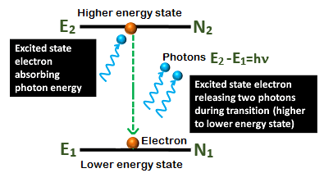
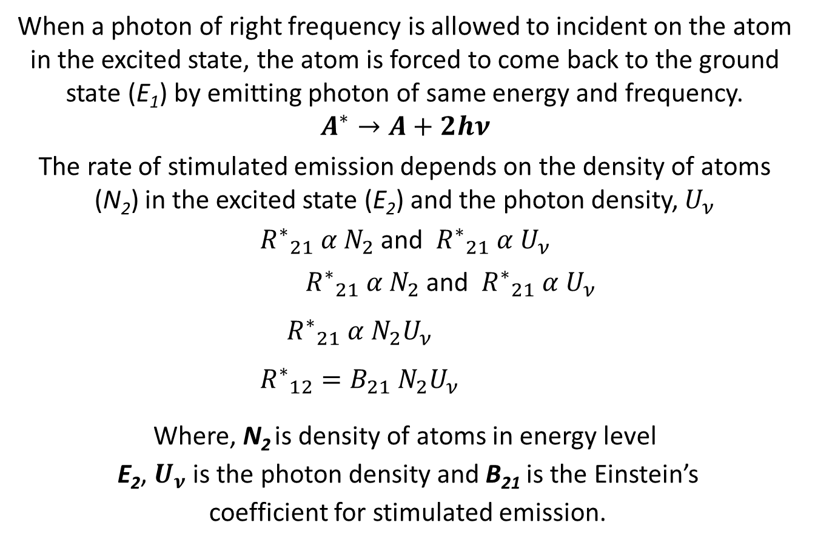
Stimulated Emission
When a photon of right frequency is allowed to incident on the atom in the excited state, the atom is forced to come back to the ground state (E₁) by emitting photon of same energy and frequency.
$$A^{∗}→A+2hν$$
The rate of stimulated emission depends on the density of atoms (N₂) in the excited state (E₂) and the photon density, $U_{ν}$
${R^{∗}}_{21} α{ N}_{2}$ and ${R^{∗}}_{21} α U_{ν}$
${R^{∗}}_{21} α{ N}_{2}$ and ${R^{∗}}_{21} α U_{ν}$
$${R^{∗}}_{21} α{ N}_{2}U_{ν}$$
$${R^{∗}}_{12}=B_{21}{ N}_{2}U_{ν}$$
Where, N₂ is density of atoms in energy level E₂, $U_{ν}$is the photon density and B₂₁ is the Einstein’s coefficient for stimulated emission.

Slide 21
Population Inversion
Necessary condition for laser action is that the number of atoms in a high energy state must exceed the number in a lower level
Population Inversion – condition having the population of high energy state greater than the population of lower level
It is called an "inversion" because in many familiar and commonly encountered physical systems, this is not possible.
In laser systems, population inversion is achieved by the process called pumping

Slide 22
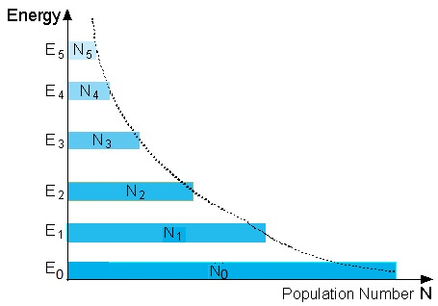

Population Inversion
In a system consisting of large number of atoms, the distribution of atoms in different energy levels is given by Maxwell-Boltzmann distribution function.
At thermal equilibrium the relative population of the excited state with respect to the ground state is given by the Boltzmann’s factor
$\frac{{ N}_{i}}{{ N}_{0}}=e^{−\left(\frac{E_{2}−E_{1}}{KT}\right)}$ $=$ $e^{−\left(\frac{hν}{KT}\right)}$
N_{i} – Number of atoms in i^{th} state with energy E_{i}
N₀ - Number of atoms in ground state
The atoms densities in the lower energy state (N₀) will be more compared to that of higher energy state (N_{i}), i.e., N₀>>N_{i}

Slide 23
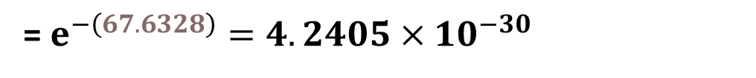
Numerical Problems
Two energy levels are separated by 1.75 eV. Calculate the ratio of populations at 300K.
$\frac{{ N}_{2}}{{ N}_{1}}=e^{−\left(\frac{E_{2}−E_{1}}{KT}\right)}$ $=$ $e^{−\left(\frac{1.75×1.6×{10}^{−19}}{1.38×{10}^{−23}×300}\right)}$
= $e^{−\left(67.6328\right)}=4.2405×{10}^{−30}$

Slide 24

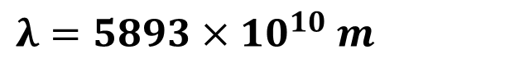
Numerical Problems
What fraction of sodium atom is in the first excited state in a sodium vapour lamp at a temperature of 250 °C ?
$λ=5893×10^{10} m$
$$E_{2}−E_{1}=hν=\frac{hc}{λ}$$
$$E_{2}−E_{1}=\frac{6.626×10^{−34}×3×10^{8}}{5893×10^{10}}=3.373×10^{−19} J$$
$\frac{{ N}_{2}}{{ N}_{1}}=e^{−\left(\frac{E_{2}−E_{1}}{KT}\right)}$ $=$ $e^{−\left(\frac{3.373×10^{−19}}{1.38×{10}^{−23}×(250+273)}\right)}$= $e^{−\left(46.7364\right)}=5.0423×{10}^{−21}$

Slide 25



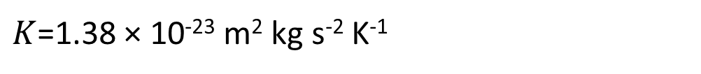
Numerical Problems
The ratio of population of two energy levels is 1.059 × 10⁻³⁰. Find the wavelength of light emitted at 330K ?
$$\frac{{ N}_{2}}{{ N}_{1}}=e^{−\left(\frac{ΔE}{KT}\right)}$$
$$ΔE=−KT ln\left(\frac{{ N}_{2}}{{ N}_{1}}\right)$$
$K$=1.38 × 10⁻²³ m² kg s⁻² K⁻¹
$$ΔE=−\text{1.38 × 10}\text{−23}\text{ ×} 330 \text{×} ln\left(1.059\text{×}{10}^{−30}\right)$$
$$ΔE=3.14\text{× 10}\text{−}\text{19} \text{J}$$
$$ΔE=\frac{hc}{λ}$$
$$λ=6.33×{10}^{−7}m$$

Slide 26
Numerical Problems
A laser beam emits an output power of 3 mW . If it is focused to a spot of radius 20 𝜇𝑚, on the retina calculate the intensity of the laser beam.
$$Intensity=\frac{Power}{Area}=\frac{3×{10}^{−3}}{π×{\left(20×{10}^{−6}\right)}^{2}}=2.387×{10}^{6} Wm^{−2}$$

Slide 27
Relation between Einstein’s coefficients and energy density of radiation

Slide 28
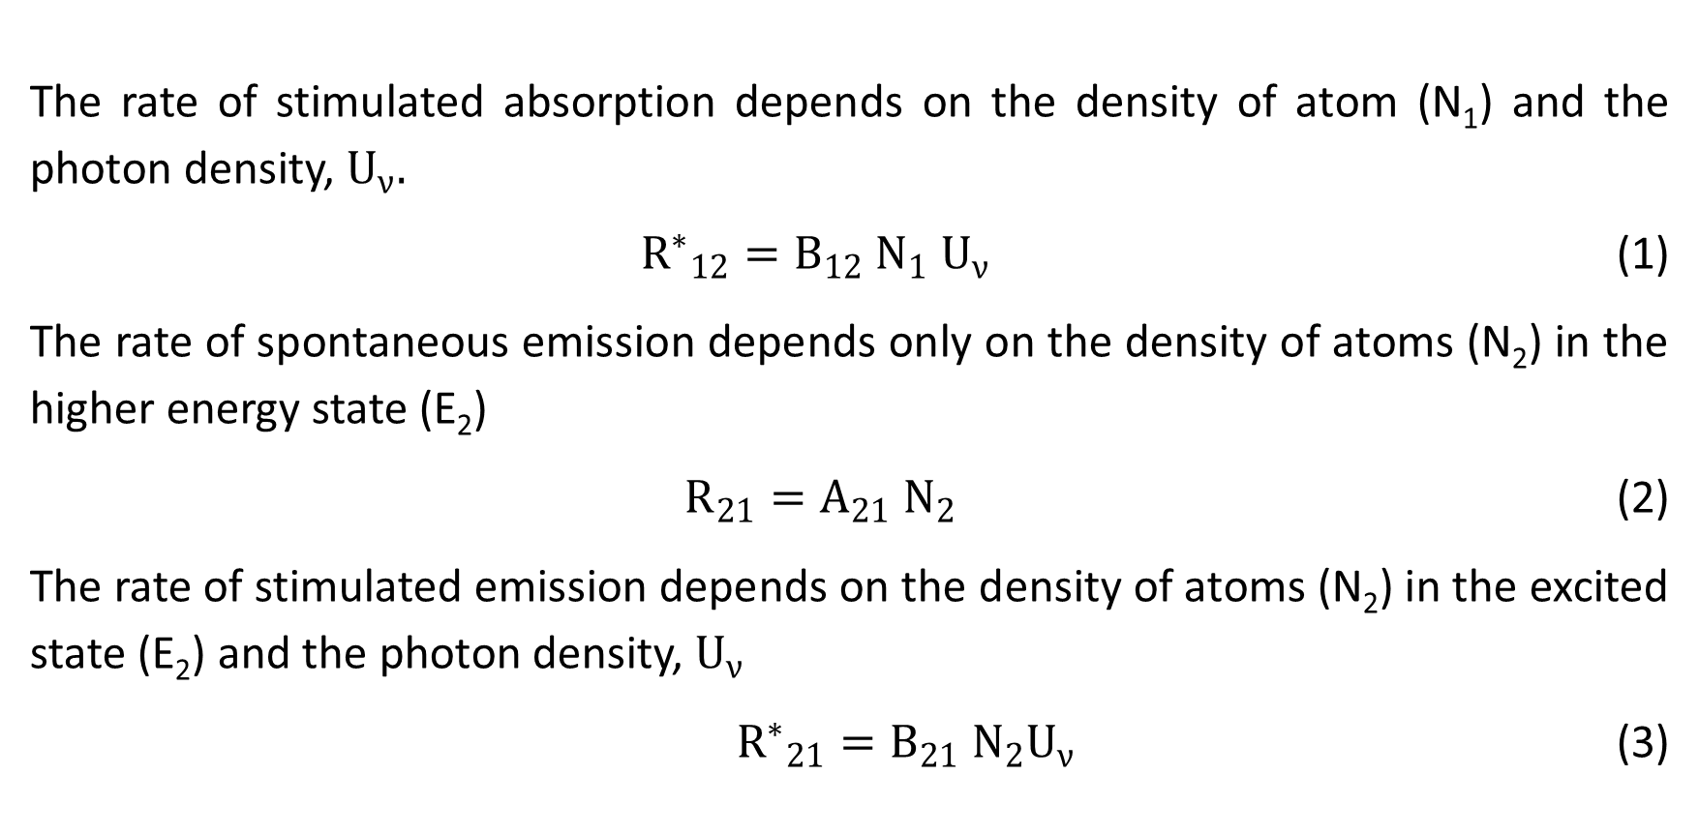
Relation between Einstein’s coefficients and energy density of radiation
The rate of stimulated absorption depends on the density of atom (N₁) and the photon density, $U_{ν}.$
${R^{∗}}_{12}=B_{12}{ N}_{1} U_{ν}$ (1)
The rate of spontaneous emission depends only on the density of atoms (N₂) in the higher energy state (E₂)
$R_{21}=A_{21}{ N}_{2}$ (2)
The rate of stimulated emission depends on the density of atoms (N₂) in the excited state (E₂) and the photon density, $U_{ν}$
${R^{∗}}_{21}=B_{21}{ N}_{2}U_{ν}$ (3)

Slide 29
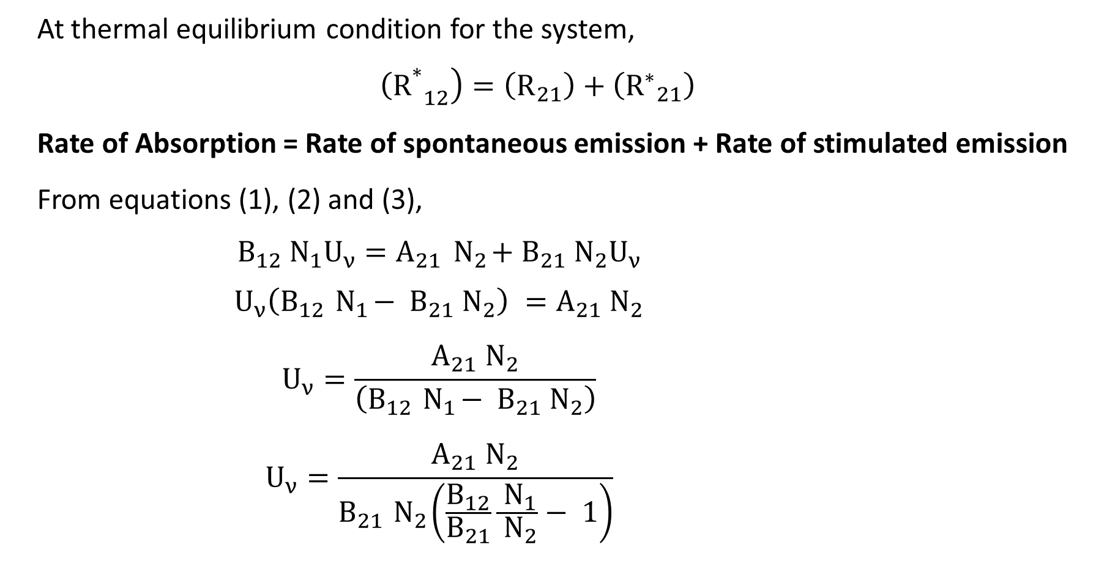
Relation between Einstein’s coefficients and energy density of radiation
At thermal equilibrium condition for the system,
$$\left. {{\left(R\right.}^{∗}}_{12}\right)=\left(R_{21}\right)+\left({R^{∗}}_{21}\right)$$
Rate of Absorption = Rate of spontaneous emission + Rate of stimulated emission
From equations (1), (2) and (3),
$$B_{12}{ N}_{1}U_{ν}=A_{21}{ N}_{2}+B_{21}{ N}_{2}U_{ν}$$
$$U_{ν}\left(B_{12}{ N}_{1}− B_{21}{ N}_{2}\right) =A_{21}{ N}_{2}$$
$$U_{ν}=\frac{A_{21}{ N}_{2}}{\left(B_{12}{ N}_{1}− B_{21}{ N}_{2}\right)}$$
$$U_{ν}=\frac{A_{21}{ N}_{2}}{B_{21}{ N}_{2}\left(\frac{B_{12}}{B_{21}}\frac{{ N}_{1}}{{ N}_{2}}− 1\right)}$$

Slide 30
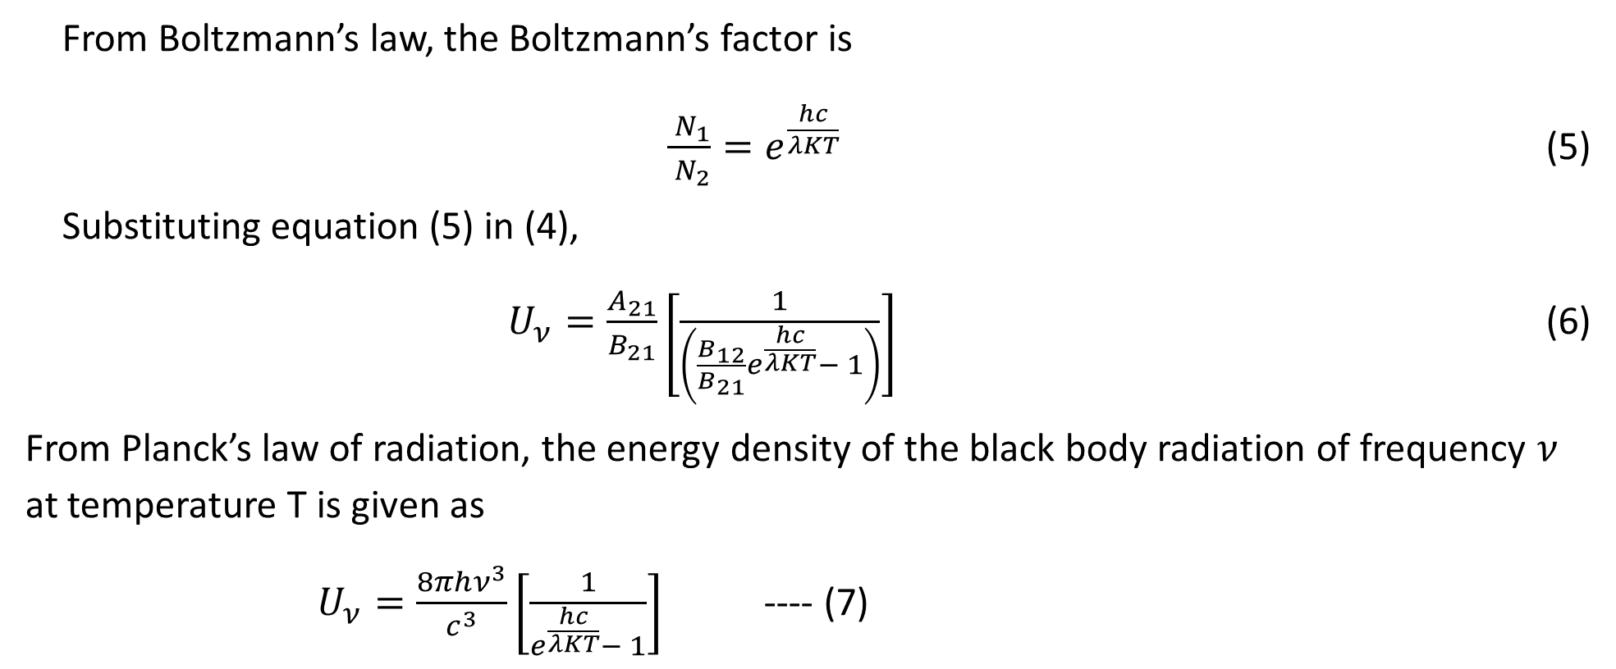
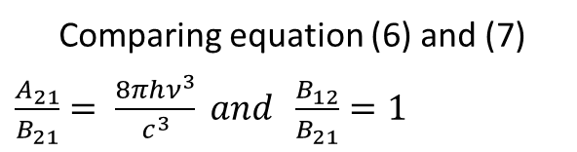
Relation between Einstein’s coefficients and energy density of radiation
$U_{ν}=\frac{A_{21}}{B_{21}}\left[\frac{1}{\left(\frac{B_{12}}{B_{21}}\frac{{ N}_{1}}{{ N}_{2}}− 1\right)}\right]$ (4)
From Boltzmann’s law, the Boltzmann’s factor is
$\frac{{ N}_{1}}{{ N}_{2}}=e^{\frac{hc}{λKT}}$ (5)
Substituting equation (5) in (4),
$U_{ν}=\frac{A_{21}}{B_{21}}\left[\frac{1}{\left(\frac{B_{12}}{B_{21}}e^{\frac{hc}{λKT}}− 1\right)}\right]$ (6)
From Planck’s law of radiation, the energy density of the black body radiation of frequency $ν$ at temperature T is given as
$U_{ν}=\frac{8πhν^{3}}{c^{3}}\left[\frac{1}{e^{\frac{hc}{λKT}}− 1}\right]$ ---- (7)
Comparing equation (6) and (7) $\frac{A_{21}}{B_{21}}= \frac{8πhν^{3}}{c^{3}} and \frac{B_{12}}{B_{21}}=1$

Slide 31
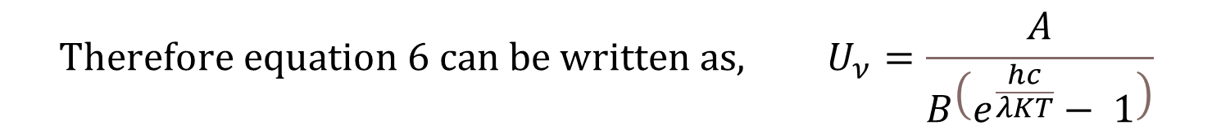

Relation between Einstein’s coefficients and energy density of radiation
$$\frac{A_{21}}{B_{21}}= \frac{8πhν^{3}}{c^{3}} and \frac{B_{12}}{B_{21}}=1$$
$${Therefore equation 6 can be written as, U}_{ν}=\frac{A}{B\left(e^{\frac{hc}{λKT}}− 1\right)}$$

Slide 32
Ratio of stimulated emission to spontaneous emission

Slide 33

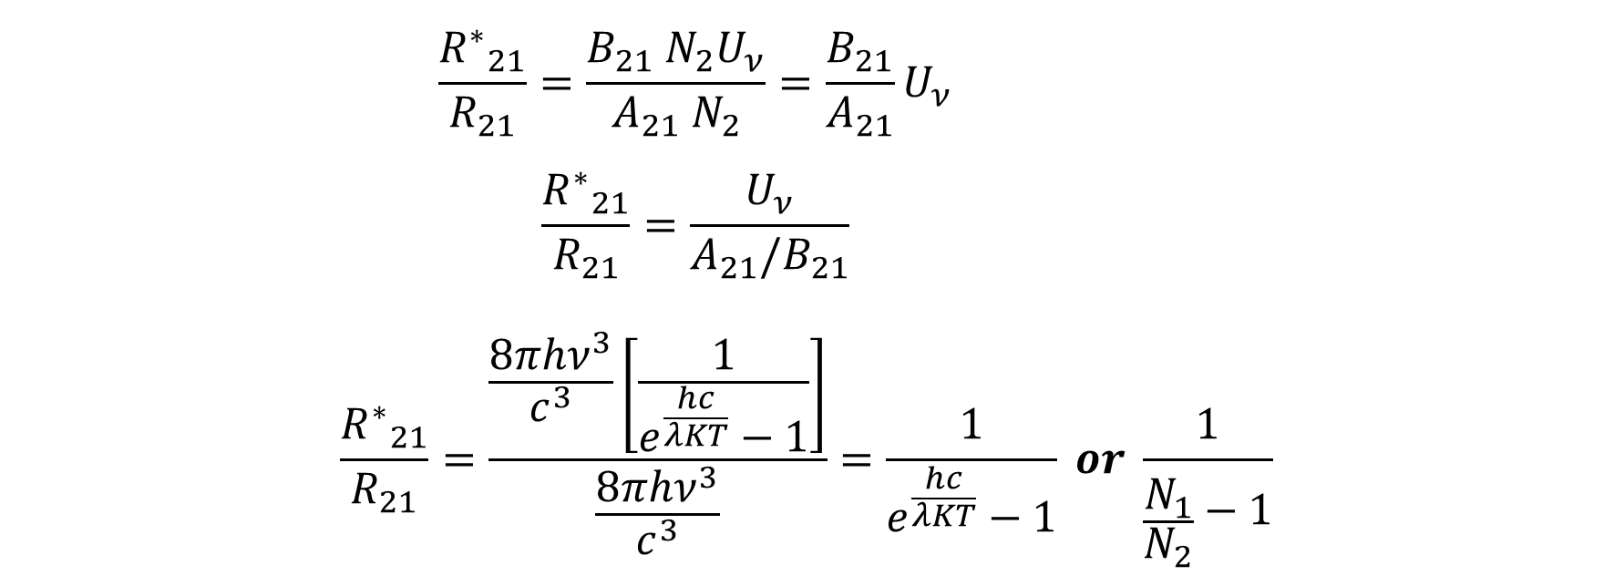
Ratio of stimulated emission to spontaneous emission
$$\frac{{R^{∗}}_{21}}{R_{21}}=\frac{B_{21}{ N}_{2}U_{ν}}{A_{21}{ N}_{2}}=\frac{B_{21}}{A_{21}}U_{ν}$$
$$\frac{{R^{∗}}_{21}}{R_{21}}=\frac{U_{ν}}{A_{21}/B_{21}}$$
$$\frac{{R^{∗}}_{21}}{R_{21}}=\frac{\frac{8πhν^{3}}{c^{3}}\left[\frac{1}{e^{\frac{hc}{λKT}}−1}\right]}{\frac{8πhν^{3}}{c^{3}}}=\frac{1}{e^{\frac{hc}{λKT}}−1} or \frac{1}{\frac{N_{1}}{N_{2}}−1}$$
$\frac{{R^{∗}}_{21}}{R_{21}}=$ $\frac{1}{\frac{N_{1}}{N_{2}}−1}$

Slide 34
Ratio of stimulated emission to spontaneous emission
As N₁/N₂ >> 1 , the number of stimulated emission is insignificant compared to that of the spontaneous emission
Einstein ‘s coefficient A₂₁ = 1/τ
where, τ is the relaxation time of the excited state

Slide 35

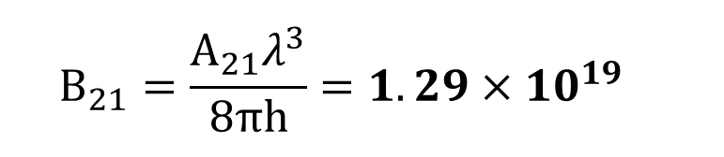
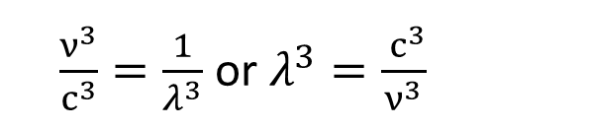
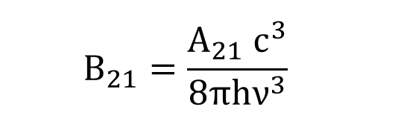
Numerical Problems
The wavelength of emission is 6000 Å and the Einstein’s coefficient of spontaneous emission is 10⁶ /s. Determine the coefficient for the stimulated emission.
$$\frac{A_{21}}{B_{21}}= \frac{8πhν^{3}}{c^{3}}$$
$\frac{ν^{3}}{c^{3}}=\frac{1}{λ^{3}}$ or $λ^{3}=\frac{{ c}^{3}}{ν^{3}}$
$$A_{21}={10}^{6} s^{−1}$$
$$B_{21}=\frac{A_{21}{ c}^{3}}{8πhν^{3}}$$
$$B_{21}=\frac{A_{21}λ^{3}}{8πh}=1.29×{10}^{19}$$

Slide 36




Numerical Problems
The Einstein coefficient for spontaneous emission for a certain transition in a molecule is
1.5×10⁷ s⁻¹. Calculate the lifetime of the excited state associated with this transition.
$$A21 =\frac{1}{τ}$$
$$τ=\frac{1}{A21}$$
$$τ=\frac{1}{1.5×{10}^{7}}$$
$$τ=6.666×{10}^{−8} s$$

Slide 37
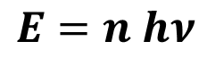
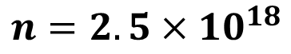
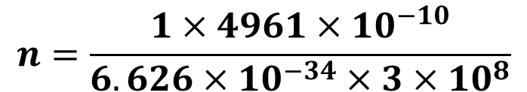
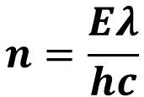
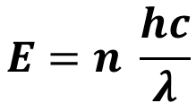
Numerical Problems
Calculate the number of photons, from green light of mercury ( λ = 4961 Å) required to do one joule of work.
$$E=n hν$$
$$E=n \frac{hc}{λ}$$
$$n=\frac{Eλ}{hc}$$
$$n=\frac{1×4961×10^{−10}}{6.626×10^{−34}×3×10^{8}}$$
$$n=2.5×10^{18}$$

Slide 38
Numerical Problems
A photon of wavelength 400 nm is emitted when an atom in an excited state transits to ground state. Calculate the energy and momentum of the photon. What is the ratio of populations of the two states at 300 K?
$Energy of the photon=E_{2}−E_{1}=\frac{hc}{λ}=\frac{6.626×{10}^{−34}×3×{10}^{8}}{400×{10}^{−9}}=4.95$ $×{10}^{−19}$
$$Energy of the photon in electron volts=\frac{4.95 ×{10}^{−19}}{1.6×{10}^{−19}}=3.093 eV$$
$$Momentum of the photon=\frac{h}{λ}=\frac{6.626×{10}^{−34}}{400×{10}^{−9}}=1.65×{10}^{−27} kgm/s$$
$Ratio of populations=\frac{{ N}_{2}}{{ N}_{1}}=e^{−\left(\frac{E_{2}−E_{1}}{KT}\right)}$ $e^{−\left(\frac{4.95 ×{10}^{−19}}{1.38×{10}^{−23}×300}\right)}$= $e^{−\left(119.56\right)}=1.1843×{10}^{−52}$

Slide 39
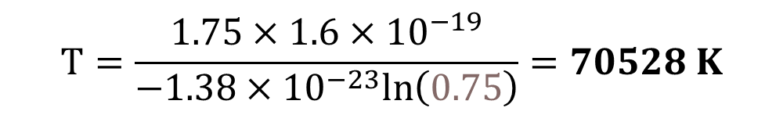


Numerical Problems
Two energy levels are separated by 1.75 eV. Calculate the temperature at which the ratio of populations is equal to 0.75
$$E_{2}−E_{1}=1.75×1.6×10^{−19} J$$
$$\frac{{ N}_{2}}{{ N}_{1}}=e^{−\left(\frac{E_{2}−E_{1}}{KT}\right)}$$
$$ΔE=−KT ln\left(\frac{{ N}_{2}}{{ N}_{1}}\right)$$
$$T=\frac{E_{2}−E_{1}}{−K ln\left(\frac{{ N}_{2}}{{ N}_{1}}\right)}$$
$$T=\frac{1.75×1.6×10^{−19}}{−1.38×{10}^{−23}ln\left(0.75\right)}=70528 K$$

Slide 40
Population inversion and pumping

Slide 41
Population inversion and pumping
Population inversion is the condition in which the number of atoms (N₂) in an excited state will be more than the number of atoms (N₁) in the ground state
Or, Population inversion is the condition in which N₂ >> N₁
Population inversion is achieved by using a process called Pumping
It is called an "inversion" because in many familiar and commonly encountered physical systems, this is not possible.
Pumping is the process of supply of excitation energy to create population inversion

Slide 42
Pumping methods
Different types of pumping
Optical – using high intensity light or by operating flash tube (Ruby Laser)
Electric discharge – using high potential difference between the cathode and anode (Ar Laser & He-Ne Laser)
Atom-Atom collision – excited atoms collide with other atoms and transfer energy (He-Ne Laser)
Electric current – pushing large number of electrons and holes to the junction (Semiconductor Laser)

Slide 43
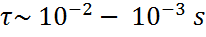
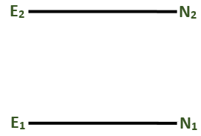
Metastable state
The state of population inversion is sustainable only when the excited state is a having longer relaxation time
B₂₁ is significant
pumping
Metastable states are the energy states with longer relaxation time, τ (≈ 10⁻² s to 10⁻³ s)

Slide 44
Metastable state
In a metastable state, an atom or molecule is excited to a particular energy level that has a longer-than-normal lifetime.
This means that the excited electron stays in this higher energy state for a relatively long time before returning to a lower energy state and emitting light.
Because of this longer lifetime, metastable states can store energy for longer periods.

Slide 45
Metastable state
A metastable state refers to an excited state of an atom, molecule, or nucleus that has a relatively long lifetime compared to other excited states but is not the lowest energy state available.

Slide 46
Two-Level System
E₂, N₂
E₂, N₂
E₁, N₁
E₁, N₁

Slide 47
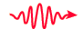

Three-Level System
E3
RAPID DECAY
UPPER LASING LEVEL
E2
PUMPING
E1
LOWER LASING LEVEL

Slide 48
Two-, three-, and four-level systems
Three-level system
Two-level system
Four-level system
Fast decay
Fast decay
Pump Transition
Pump Transitin
Laser Transition
Laser Transition
Laser Transition
Pump Transition
Fast decay

Slide 49

Amplification of photons
These photons that are emitted by spontaneous or stimulated emission processes are not sufficient to create a large number of further stimulated emissions that are required to build a sufficient intensity for a laser beam

Slide 50
Resonating cavity and Requisite conditions for production of a laser beam

Slide 51
Resonating cavity
M₁
M₂
Amplification occurs when the photons emitted in stimulated emission are reflected back into the system and trigger further stimulated emissions
Resonating cavity is a cavity consists of two mirrors (M₁ & M₂ with R of 100% & <100%, respectively), placed parallel to each other, which will facilitate the amplification of photons

Slide 52

Resonating cavity
M₁
M₂
Only the photons that are moving parallel to the axis of the resonating cavity will be reflected back and forth between the mirrors and hence actively trigger further stimulated emissions

Slide 53
Requisite conditions for production of a laser beam
For lasing we need
An active medium (lasing medium) with metastable state
Pumping mechanism to produce population inversion and hence stimulated emission
Resonating cavity to amplify the laser radiation
M₁
M₂
pumping

Slide 54
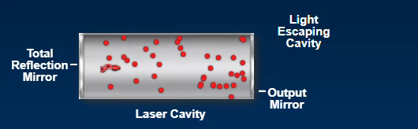
Requisite conditions for production of a laser beam

Slide 55
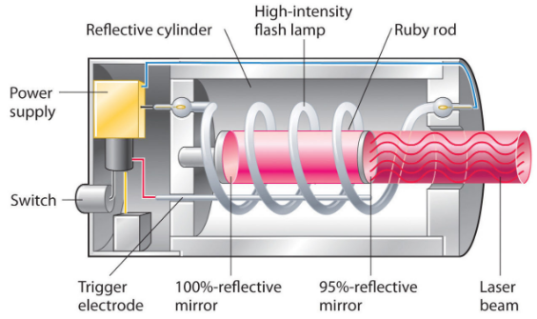
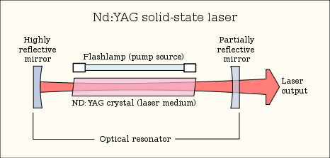
Types of laser
Solid state lasers
Ex. Ruby (Al₂O₃ doped with 5% Cr³⁺ ions)
Nd-YAG (neodymium-doped yttrium aluminum garnet)
Pump using optical flash tube
Ruby
Nd-YAG

Slide 56
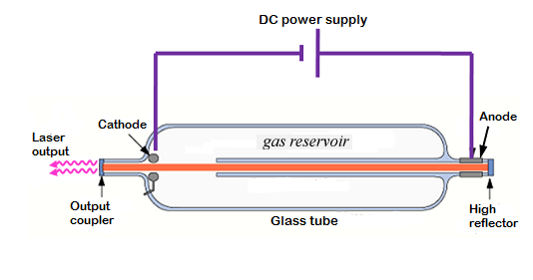
Types of laser
Gas lasers
Ex. He-Ne, Ar, N, CO₂
Pump using electric discharge and/or atom-atom collision

Slide 57

Types of laser
Semiconductor lasers
Ex. GaAs, InAs
Pump using electric current

Slide 58

Types of laser
Chemical lasers
Ex.
Hydrogen fluoride (HF)/deuterium fluoride (DF) laser
Chemical oxygen iodine laser (COIL)
All gas-phase iodine laser (AGIL)
Laser levels are rotational and vibrational levels of the molecule

Slide 59

Types of laser
Dye lasers
Uses organic dye as the lasing medium, usually as a liquid solution
Florescent dyes dissolved, in suitable solvents, absorbs light at one wavelength and emit at another wavelength

Slide 60




Numerical Problems
If the coherence length of a laser source is 500 m and the wavelength used in it is 6328 Å. Calculate the band width and frequency spread.
𝑙_{𝑐} is coherence length and c is the velocity of light
∆υ = frequency spread
$$Coherence Length l_{c}=\frac{c}{Δν};so frequency spread Δν=\frac{c}{l_{c}}=6×{10}^{5} Hz$$
$$Frequency=ν=\frac{c}{λ}=4.7×{10}^{14} Hz$$
$$\frac{c}{Δν}=\frac{Δλ}{λ^{2}}=l_{c}$$
$$Δν=\frac{c}{λ^{2}}Δλ$$
Temporal coherence is a measure of the correlation between the phases of a light wave at different points along the direction of propagation. Temporal coherence tells us how monochromatic a source is.
$Δλ=\frac{λ^{2}}{l_{c}}=8×{10}^{−16}$ m

Slide 61


Numerical Problems
The relative population at room temperature (300 K) of a two level system having ground state energy E₁ and excited state energy E₂ is $\frac{N_{2}}{N_{1}}=1.2×{10}^{−30}$. Find the wavelength of light emitted during the transition from E₂ to E₁ . (K=1.38×10⁻²³J/K)
$$\frac{{ N}_{2}}{{ N}_{1}}=e^{−\left(\frac{E_{2}−E_{1}}{KT}\right)}$$
$$\frac{{ N}_{2}}{{ N}_{1}}=e^{−\left(\frac{hc}{λKT}\right)}$$
$$ln\left(\frac{{ N}_{2}}{{ N}_{1}}\right)=−\left(\frac{hc}{λKT}\right)$$
$$λ=−\left(\frac{hc}{KTln\left(\frac{{ N}_{2}}{{ N}_{1}}\right)}\right)=6.9692×{10}^{−7}m$$

Slide 62



Numerical Problem
A laser pulse of duration 1 ms has a power of 10 mW . If the number of photons
emitted in pulse are 10¹⁰ , calculate the wavelength of the emitted photons
Number of photons emitted in 10⁻³ s is 10¹⁰
Number of photons emitted in 1 sec = 10¹³
$$Power=N \frac{hc}{λ}$$
$$λ=N \frac{hc}{P}$$
$$λ={10}^{13}×\frac{6.626×{10}^{−34}×3×{10}^{8}}{10×{10}^{−3}}=1.98×{10}^{−10} m$$

Slide 63
Class Test
Derive the Relation between Einstein’s coefficients and energy density of radiation
Derive the Ratio of stimulated emission to spontaneous emission
The wavelength of emission is 5000 Å and the Einstein’s coefficient of spontaneous emission is 1.5 × 10⁶ /s. Determine the coefficient for the stimulated emission.

Slide 64
He-Ne laser

Slide 65

He-Ne laser
Helium–neon laser at the University of Chemnitz, Germany

Slide 66

Components of laser system
Active medium
Medium in which the laser action takes place
Pump
Energy source to raise the atoms/molecules of the active medium from the lower energy state to higher energy state
Resonating cavity
Consists of two high reflective mirrors placed parallel to each other

Slide 67



He-Ne laser
Schematic
Construction
The He-Ne laser consists of a quartz discharge tube of length ≈ 1m and diameter ≈ 5mm
The discharge tube is filled with He and Ne gas in the ratio 10:1 at a pressure of 1.5 to 5 Torr.
The tube is fitted with high voltage battery to create electric discharge.
Two mirrors placed outside the discharge tube forms resonating cavity.
The two ends of the discharge tube are fitted with Brewster’s window (used as polarizers).

Slide 68
He-Ne laser
Active medium
A mixture of He and Ne gases in the ratio 10:1, at a partial pressure of 1.5 to 5 Torr, is the active medium.
Ne is the lasing atom and He is used to pump the Ne atom to the excited state.
Pumping
This is a two stage process in He-Ne lasers
Electric discharge created in the discharge tube accelerates the electrons, which are passed through the gaseous mixture, and excites He atom.
He atom collides with Ne atom and excites it to higher energy through atomic collision.

Slide 69







He-Ne laser
1-3 kV DC Power supply
Discharge tube

Slide 70

He-Ne laser
Working
Electric discharge produces electrons (e⁻) with high kinetic energy moving inside the tube.
He atoms are raised from ground state (1s) to excited state (2s) by collisions with electron moving with high KE
e⁻(High KE) + He → He* + e⁻ (Low KE)
Excited He atom collide with Ne atoms and transfer Ne atom to 4s or 5s excited levels.
He* + Ne(ground) + KE of He → Ne*+ He

Slide 71
He-Ne laser
Working
Population inversion occurs between 5s & 4p, 5s & 3p and 4s & 3p. The corresponding transitions are
5s to 4p → 3.39 μm
5s to 3p → 632.8 nm
4s to 3p → 1.15 μm
Ne atom decays to 3s level by spontaneous emission and decay to ground state by colliding with the walls of the discharge tube.

Slide 72
He-Ne laser
The wavelength of 632.8 nm is selectively amplified by adjusting the distance between the mirrors.
1-3 kV DC Power supply
The photons moving parallel to the axial direction are reflected back and forth between the mirrors until sufficient intensity is built to transmit from partially reflecting mirror.
The output is the plane polarized and continuous laser of wavelength 632.8 nm.
Discharge tube

Slide 73
He-Ne laser
Pressure of Helium is nearly ten times that of Neon
Electrodes are connected to high voltage source of few kV dc
Mirrors are placed outside the tube with end windows of the tube placed at Brewster’s angle
Ray of light incident at the Brewster’s angle, the reflected light is polarized perpendicular to the plane of reflection
Only component oscillating parallel to the plane of incidence will sustain laser emission and light emerging from laser is linearly polarized

Slide 74



1-3 kV DC Power supply
M₁
M₂
Discharge tube

Slide 75

Numerical Problem
The efficiency of He-Ne laser is 16.66 % when it is operated with a current of 1 mA at
1 KV. Calculate the power output in mW
$$Input power=VI=1×{10}^{3}×1×{10}^{−3}=1 W$$
$$Efficiency=\frac{Output power}{Input power}=0.1666$$
$$Output power=0.166 W=166 mW$$

Slide 76

Numerical Problem
In a He-Ne laser system, the two energy levels of Ne involved in lasing action have energy values of 20.66 eV and 18.7 eV. Calculate the ratio of populations between the two levels at 27 °C
$$The energy difference ∆E=1.96 eV;T=27+273=300K$$
$$The ratio of populations=\frac{N_{2}}{N_{1}}=e^{−\left(\frac{E_{2}−E_{1}}{KT}\right)}$$
$$The ratio of populations=\frac{N_{2}}{N_{1}}=e^{−\left(\frac{1.96×1.6×{10}^{−19}}{1.38×{10}^{−23}×300}\right)}=1.266×{10}^{−33}$$

Slide 77



Numerical Problem
A He-Ne laser emits light at a wavelength of 632.8 nm and has an output power of 2.3 mW. How many photons are emitted in each minute by this laser when operating?
$$E=\frac{hc}{λ}$$
$$E=\frac{6.626×{10}^{−34}×3×{10}^{8}}{632.8×{10}^{−9}}=3.1412×{10}^{−19} J$$
$$Photons emitted per second=\frac{Output power}{Energy of 1 photon}$$
$$Photons emitted per second=\frac{2.3×{10}^{−3}}{3.1412×{10}^{−19}}=7.3218×{10}^{15}$$
$$Photons emitted per minute=7.3218×{10}^{15}×60$$
$$Photons emitted per minute=4.3931×{10}^{17}$$
Therefore, the He-Ne laser emits $4.3931×{10}^{17}$ photons per minute when operating.

Slide 78
Semiconductors laser

Slide 79
Semiconductors
Semiconductors are the solid substances that has a conductivity between that of an insulator and that of most metals.
They posses a energy gap (E_{g}) between the valence band and conduction band.
Examples: Ge (0.7eV), Si (1.1eV), GaAs (1.42eV), GaP (2.25eV), etc.,
Semiconductors posses negative temperature coefficients of resistance, i.e. as temperature increases resistivity decreases

Slide 80

Semiconductors
II
III
IV
V
VI
Elemental | IV Compounds | III-V Compounds | II-VI Compounds
Si, Ge | SiC | AIP, AIAs, AISb, GaP, GaAs, GaSb, InP, lnAs, InSb | ZnS, ZnSe, ZnTe, CdS, CdSe, CdTe
Semiconductors can be
Elemental – Si, Ge
Compound – GaAs, InP

Slide 81

Intrinsic Semiconductors
Undoped semiconductors
E_{C}
E_{g}
E_{F} = E_{g}/2
E_{V}
In Intrinsic semiconductors, we need to supply an amount of energy equal to bandgap energy to excite an electron from V.B. to conduction band
Fermi level E_{F} lies in the middle of band gap
In intrinsic semiconductors, the number of holes (n_{h}) is equal to number of electrons (n_{e})

Slide 82


Extrinsic Semiconductors
Doped semiconductors
p-type
n-type
n_{h} > n_{e}
n_{e} > n_{h}

Slide 83
p-type Semiconductors
Doped semiconductors
p-type
E_{Cp}
E_{g}
E_{Fp}
E_{Vp}
Fermi level E_{Fp} lies close to the valence band.
In p-type extrinsic semiconductors, the number of holes (n_{h}) is greater than the number of electrons (n_{e})

Slide 84
n-type Semiconductors
Doped semiconductors
n-type
E_{Cn}
E_{Fn}
E_{g}
E_{Vn}
Fermi level E_{Fn} lies close to the conduction band.
In n-type extrinsic semiconductors, the number of electrons (n_{e}) is greater than the number of holes (n_{h})

Slide 85

p-n junction
ΔV
A p-n junction is a boundary or interface between two regions of a semiconductor material, one doped with acceptor impurities (p-type) and the other doped with donor impurities (n-type).

Slide 86
Energy band diagrams of p and n type semiconductors and p-n junction
p-n junction
p-type semiconductor
E_{Cp}
E_{Cp}
n-type semiconductor
E_{Cn}
E_{Fp}
E_{Cn}
E_{Fn}
E_{Fp}
E_{Fn}
E_{Vp}
E_{Vp}
E_{Vn}
E_{Vn}
In a p-n junction the conduction and valence bands of n-type will be at lower energies than the corresponding bands in p-type, in order to equalize the Fermi level

Slide 87



Direct and indirect band gap semiconductors
Phonons are quanta of lattice vibrations in solids
Photons are quanta of electromagnetic radiation.
Energy is liberated as photon
Ex: GaAs, InP
Can be used for light emission purpose
Energy is liberated both as phonon and photon
Ex: Ge, Si
Can’t be used for light emission purpose

Slide 88

Semiconductor laser
Principle: The recombination of electrons and holes in a direct bandgap semiconductor results in emission of photons of wavelength $λ =\frac{hc}{Eg}$, where E_{g} is the bandgap.
Homojunction laser: p-n junctions involve only one p-type material and one n-type material
Heterojunction laser: Consists of more than one p-type and n-type material
Simple heterojunction
Double heterojunction

Slide 89


Semiconductors laser
Construction:
Direct bandgap, GaAs semiconductor is doped heavily with divalent and hexavalent impurities to form a p-n junction.
The top and bottom surfaces are metalized and ohmic contacts are provided for current supply.
The front and rear faces are polished to act like mirrors of an optical resonator.
The other two faces are roughened to prevent lasing action in that direction.
The active region is the p-n juction of about 1μm thickness.

Slide 90

Semiconductor laser
Pumping:
A heavy forward bias is applied to the p-n junction. Electrons are injected into conduction band of n and holes into valence band of p. This is similar to population inversion.
Working:
At thermal equilibrium, the Fermi level is uniform across the junction.
Because of very high doping on n-side, Fermi level is pushed into the conduction band and electrons occupy the portion of the conduction band lying below the Fermi level.
Un Biased
On p-side, the Fermi level lies within the valence band and holes occupy the portion of the valence band that lies above the Fermi level.

Slide 91

Semiconductor laser
Working:
At low forward current, the electron-holes recombination results in spontaneous emission of photons and the junction acts as a LED.
As the forward current is increased gradually and when it reaches a threshold value, the depletion region becomes narrow and Large concentration of electrons and holes are injected into the junction region.
As a result condition of population inversion is attained in the narrow region.
Un Biased
Forward Biased

Slide 92
Semiconductors laser
Working:
This narrow zone in which population inversion occurs is called as an active region.
A photon emitted spontaneously triggers stimulated emission, at this stage.
This stimulated electron-hole recombination produces coherent radiation.
The output wavelength depends on temperature, threshold current density, and doping concentration.
Forward Biased

Slide 93

Semiconductors laser
After the current density across the junction exceeds a particular value, light emitted is coherent
Frequency of the laser beam is $\frac{Eg}{h}$ where E_{g} is the band gap
Laser action of this kind was first achieved with GaAs
Subsequently InP, InAs, InSb, PbSe, PbS have proved to be the promising materials
Lasing action can be enhanced by having higly polished surfaces which act as mirrors in the case of a laser
Allowed frequencies are given by
$$f_{m} =\frac{nc}{2lμ}$$
Where l is the length of the cavity , c – velocity of light
μ – is R I of the medium , n = 1, 2, 3, etc. represent the modes

Slide 94
Semiconductors laser - Summary
Intrinsic semiconductors are pure form of semiconductors
Extrinsic semiconductors are doped semiconductors
In direct band gap semiconductor the minimum value of the valence band occurs at the maximum value of the conduction band
In indirect band gap semiconductor the minimum value of the valence band does not occur at the maximum value of the conduction band
In semiconductor laser, p-n junction is operated in forward bias
Doping is extremely heavy
Basic mechanism responsible for light emission is the recombination of electrons and holes in the p- n junction

Slide 95



Numerical Problem
The number of photons emitted per second by a laser of output power 1.5 W and lasing frequency 510×10¹² Hz is
$$E=nhν$$
$$n=\frac{E}{hν}$$
$$n=\frac{1.5}{6.626×{10}^{−34}×510×{10}^{12}}$$
$$n=4.438×{10}^{18} Photons per second$$

Slide 96




Numerical Problem
The bandgap energy of the GaAs semiconductor laser with wavelength 860 nm is
$$Eg=\frac{hc}{λ}$$
$$Eg=\frac{6.626×{10}^{−34}×3×{10}^{8}}{860×{10}^{−9}}$$
$$Eg=\frac{6.626×{10}^{−34}×3×{10}^{8}}{860×{10}^{−9}}$$
$$Eg=2.3113×{10}^{−19} J$$
$$Eg=2.3113×{10}^{−19}×1.6×{10}^{−19}$$
$$Eg=1.444 eV$$

Slide 97
LASER Applications

Slide 98

LASER Applications

Slide 99
Applications of lasers
Applications of lasers
Light Detection and Ranging (LiDAR)
Laser Induced Fusion (LIF)
Laser Isotope separation (LIS)

Slide 100


LiDAR – Light Detection and Ranging

Slide 101
LiDAR – Light Detection and Ranging
Lidars is similar to RADAR (RAdio Detection And Ranging)
Uses laser pulses rather than radio waves
Device can only collect information for objects the same size as the wavelength emitted or larger, but not smaller
Since the laser pulses have wavelengths 10⁵ times smaller than those of radio waves, lidars can detect much “smaller” particles

Slide 102

LiDAR – Light Detection and Ranging
Used in atmospheric pollutant studies
Working
A pulsed laser source is used to direct the laser beam into the atmosphere.
Due to the presence of particulate matter in the atmosphere, scattering will occur.
The amplitude, direction and wavelength of the scattered beam depends on the concentration, composition and dimension of the pollutants.
The backscattered beam is collected by a detector and analyzed by a processor.

Slide 103
LiDAR – Light Detection and Ranging
Working
As a general rule, more the aerosols present in the atmosphere more will be the backscattering.
Using multiple wavelengths one can tell about the size distribution of aerosols, and depolarization data can be used to determine the shape.

Slide 104
Advantage of using LASER in LiDAR
Lidars harness the fundamental properties of laser light to perform precise detection
Monochromatic – i.e. one colour (one wavelength)
Collimated – i.e. very small divergence over large distances
Very intense – i.e. lots of energy in a small area
Polarized – i.e. energy is aligned in one direction

Slide 105
LiDAR – In Atmospheric Composition Study
Lidar particularly helpful when studying the structure and composition of the atmosphere – especially concerning the very tiny aerosols and cloud particle
Lidar may be accommodated for a particular type of field study, or that measure a specific atmospheric variable, including particles, clouds, smoke, wind speed, and even the densities of oxygen or nitrogen
Aerosol is one of many types of potential atmospheric pollutants
Lidar works by emitting a laser beam directed upwards into the sky, and capturing the scattered light reflected by particles in the atmosphere into a telescope
Light received by the telescope is known as the backscattered light
Not all of the emitted laser light can be scattered directly back towards the lidar system

Slide 106
LiDAR – In Atmospheric Composition Study
Three processes may occur:
Direct backscattering of the emitted laser light that will be detected by the lidar as polarized light
Emitted beam may simply pass through the atmosphere, unscattered, or
Emitted beam may be scattered by aerosols in entirely different directions, causing depolarization of the laser signal
As a general rule, more aerosols present in the atmosphere, there will be more backscattering
Using multiple wavelengths one can tell about the size distribution of aerosols, and implementing depolarization data can tell us about their shape

Slide 107
LiDAR – Summary
LiDAR: Remote sensing technology that measures the distance by using reflected laser light
Lidar works by emitting a laser beam directed upwards into the sky, and capturing the scattered light reflected by particles in the atmosphere into a telescope

Slide 108

Laser Isotope Separation (LIS)

Slide 109
Laser Isotope Separation (LIS)
Principle
Atoms and molecules absorb light only at certain, well-defined wavelengths
Absorption at a particular wavelength leads to a well-defined change in the internal state (vibrational, rotational or electronic) of the molecular or atomic system

Slide 110

Laser Isotope Separation (LIS)
Uranium ore consists of 99.25% of ²³⁸U and 0.72% of ²³⁵U. ²³⁵U is the fissile isotope which is needed as fuel for the nuclear reactors. Therefore it is important to enrich ²³⁵U.
Working
LIS is a two stage process
In First stage ²³⁵U is selectively excited to the level E₂ using a laser beam of frequency ν₁ = (E₂- E₁)/h.
A second laser of frequency ν₂ =(E₃- E₂)/h is used to ionize the ²³⁵U.

Slide 111

Laser Isotope Separation (LIS)
Working
Since the E’₂ energy state of ²³⁸U is at a lower energy compared to E₂ energy state of ²³⁵U, the atoms of ²³⁸U will remain in the ground state.
The ionized ²³⁵U atoms will then be separated using a negatively charged collector and collected.

Slide 112


Laser Isotope Separation (LIS)

Slide 113


Fusion
When two light nuclei fuse together to form a heavier nucleus enormous energy is produced
This process occurs inside the sun and the stars
It is the most abundant and pure form of energy in nature

Slide 114

Fusion in laboratory
Fusion process requires very high temperature (~10⁸ K) and pressure(~10¹² atm)
New fusion system has been developed with the intense laser pulse system
The main lasers used in these systems are CO₂ or Nd:YAG laser

Slide 115

Fusion in laboratory

Slide 116




Laser Induced Fusion
Fuel pellet is simultaneously irradiated with large number of short pulse laser beams and it will heat the pellet in short time
This causes vaporization of the outer surface of the pellet to form plasma.
The rapid heating causes the solid boundary to leave the rest of the pellet with high speed and this initiates the fusion.

Slide 117



Thank
You

